Slide 1



Lecture Slides
Chapter 10
Mechanical Springs
© 2015 by McGraw-Hill Education. This is proprietary material solely for authorized instructor use. Not authorized for sale or distribution in any manner. This document may not be copied, scanned, duplicated, forwarded, distributed, or posted on a website, in whole or part.

Slide 2
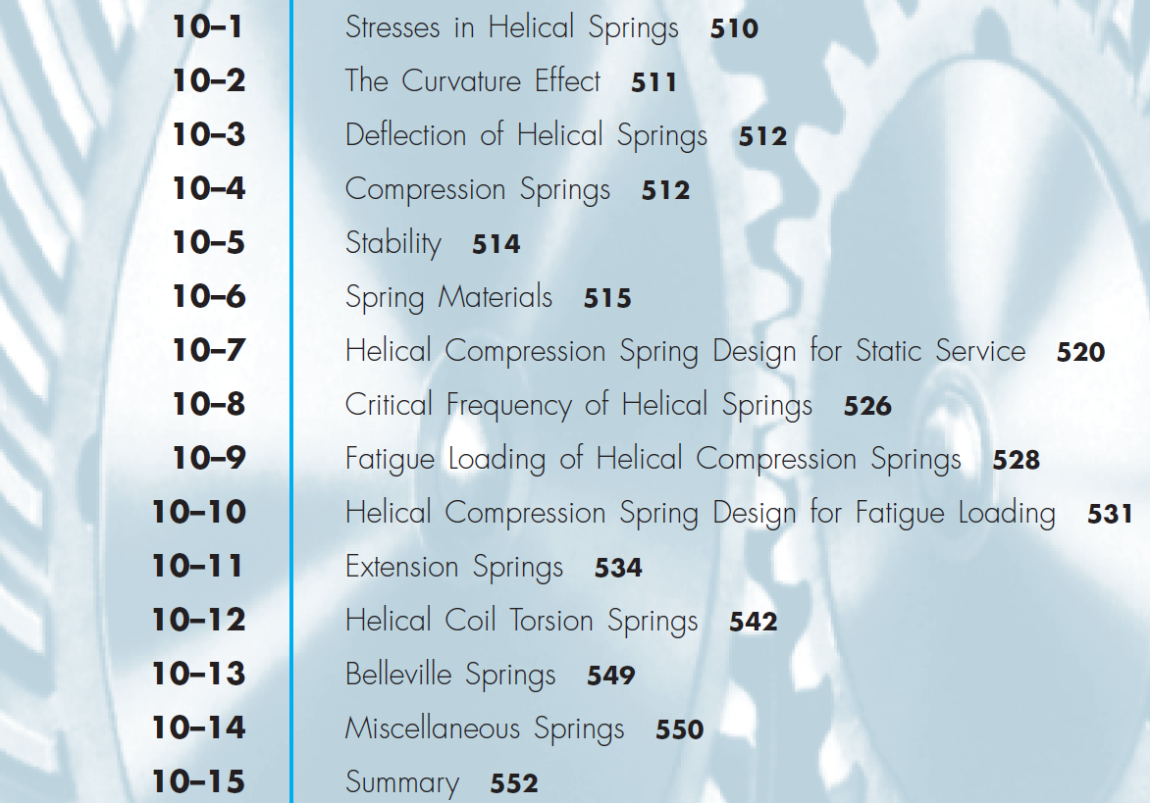
Chapter Outline

Slide 3
Mechanical Springs
Exert Force
Provide flexibility
Store or absorb energy

Slide 4
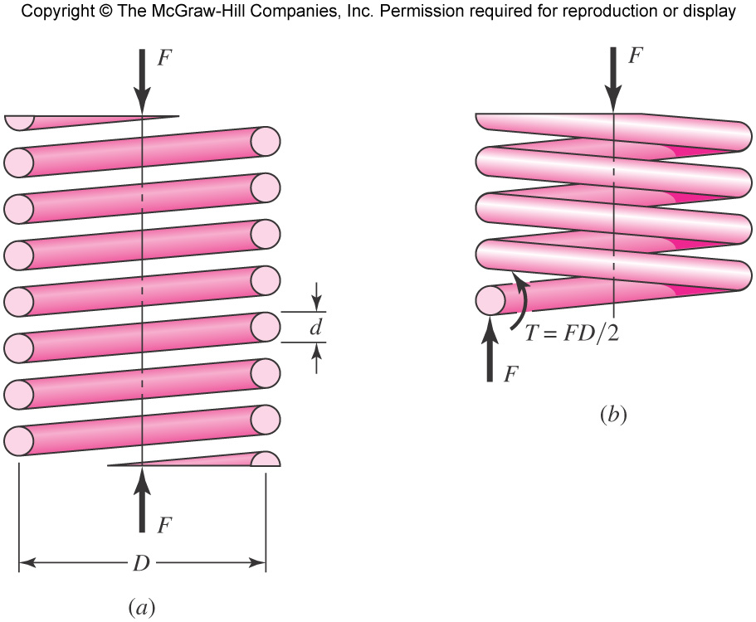
Helical Spring
Helical coil spring with round wire
Equilibrium forces at cut section anywhere in the body of the spring indicates direct shear and torsion
Fig. 10–1

Slide 5
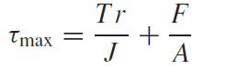
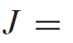
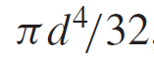
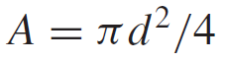
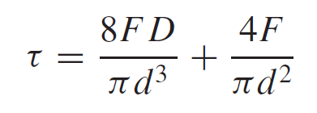
Stresses in Helical Springs
Torsional shear and direct shear
Additive (maximum) on inside fiber of cross-section
Substitute terms
Fig. 10–1b

Slide 6
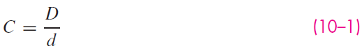
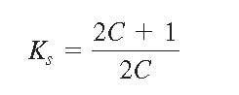
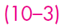
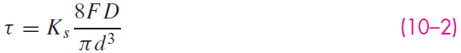
Stresses in Helical Springs
Factor out the torsional stress
Define Spring Index
Define Shear Stress Correction Factor
Maximum shear stress for helical spring

Slide 7
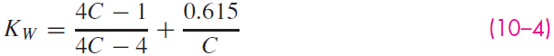
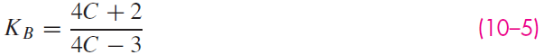
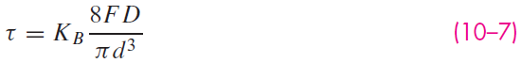
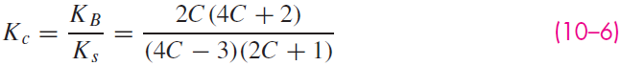
Curvature Effect
Stress concentration type of effect on inner fiber due to curvature
Can be ignored for static, ductile conditions due to localized cold-working
Can account for effect by replacing K_{s} with Wahl factor or Bergsträsser factor which account for both direct shear and curvature effect
Cancelling the curvature effect to isolate the curvature factor

Slide 8
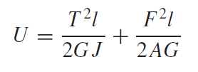
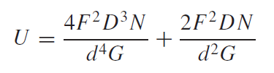
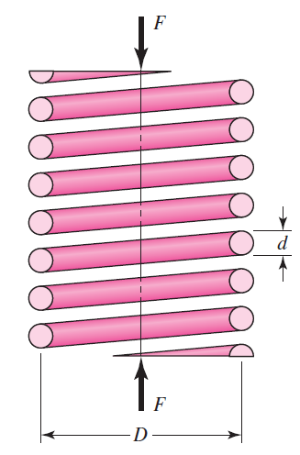
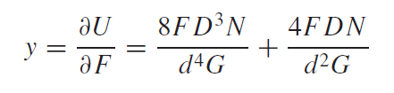
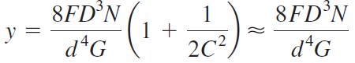
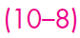
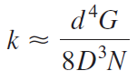
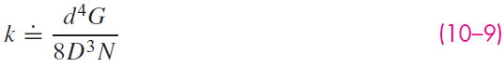
Deflection of Helical Springs
Use Castigliano’s method to relate force and deflection
Fig. 10–1a

Slide 9
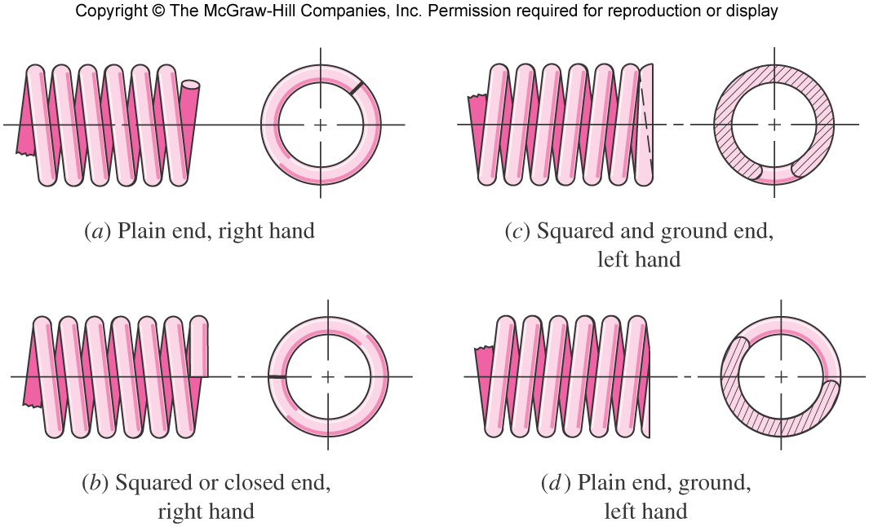
Ends of Compression Springs
Fig. 10–2

Slide 10
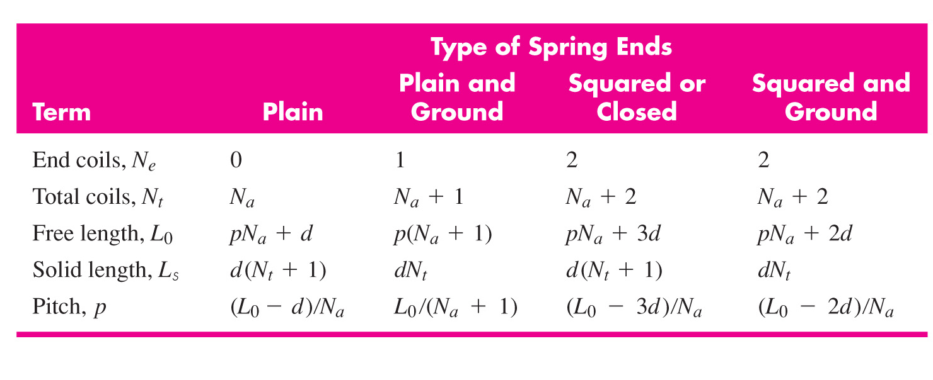
Formulas for Compression Springs With Different Ends
Table 10–1
N_{a} is the number of active coils

Slide 11
Set Removal
Set removal or presetting is a process used in manufacturing a spring to induce useful residual stresses.
The spring is made longer than needed, then compressed to solid height, intentionally exceeding the yield strength.
This operation sets the spring to the required final free length.
Yielding induces residual stresses opposite in direction to those induced in service.
10 to 30 percent of the initial free length should be removed.
Set removal is not recommended when springs are subject to fatigue.

Slide 12
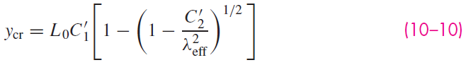
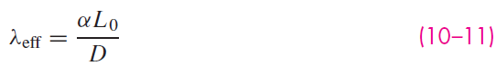
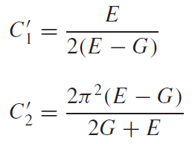
Critical Deflection for Stability
Buckling type of instability can occur in compression springs when the deflection exceeds the critical deflection y_{cr}
λ_{eff} is the effective slenderness ratio
α is the end-condition constant, defined on the next slide
C'₁ and C'₂ are elastic constants

Slide 13
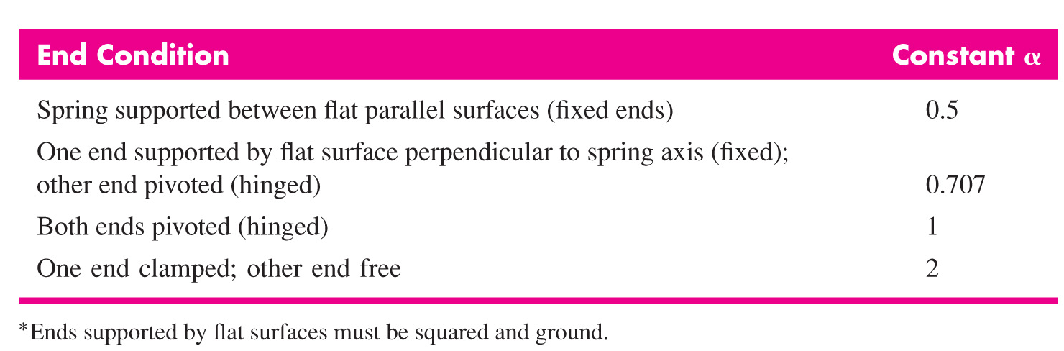
End-Condition Constant
The α term in Eq. (10–11) is the end-condition constant.
It accounts for the way in which the ends of the spring are supported.
Values are given in Table 10–2.
Table 10–2

Slide 14
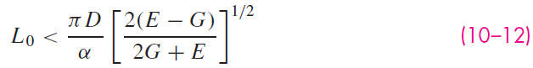
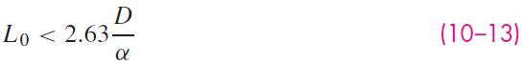
Absolute Stability
Absolute stability occurs when, in Eq. (10–10),
This results in the condition for absolute stability
For steels, this turns out to be

Slide 15
Some Common Spring Steels
Hard-drawn wire (0.60-0.70C)
Cheapest general-purpose
Use only where life, accuracy, and deflection are not too important
Oil-tempered wire (0.60-0.70C)
General-purpose
Heat treated for greater strength and uniformity of properties
Often used for larger diameter spring wire
Music wire (0.80-0.95C)
Higher carbon for higher strength
Best, toughest, and most widely used for small springs
Good for fatigue

Slide 16
Some Common Spring Steels
Chrome-vanadium
Popular alloy spring steel
Higher strengths than plain carbon steels
Good for fatigue, shock, and impact
Chrome-silicon
Good for high stresses, long fatigue life, and shock

Slide 17
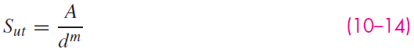
Strength of Spring Materials
With small wire diameters, strength is a function of diameter.
A graph of tensile strength vs. wire diameter is almost a straight line on log-log scale.
The equation of this line is
where A is the intercept and m is the slope.
Values of A and m for common spring steels are given in Table 10–4.

Slide 18
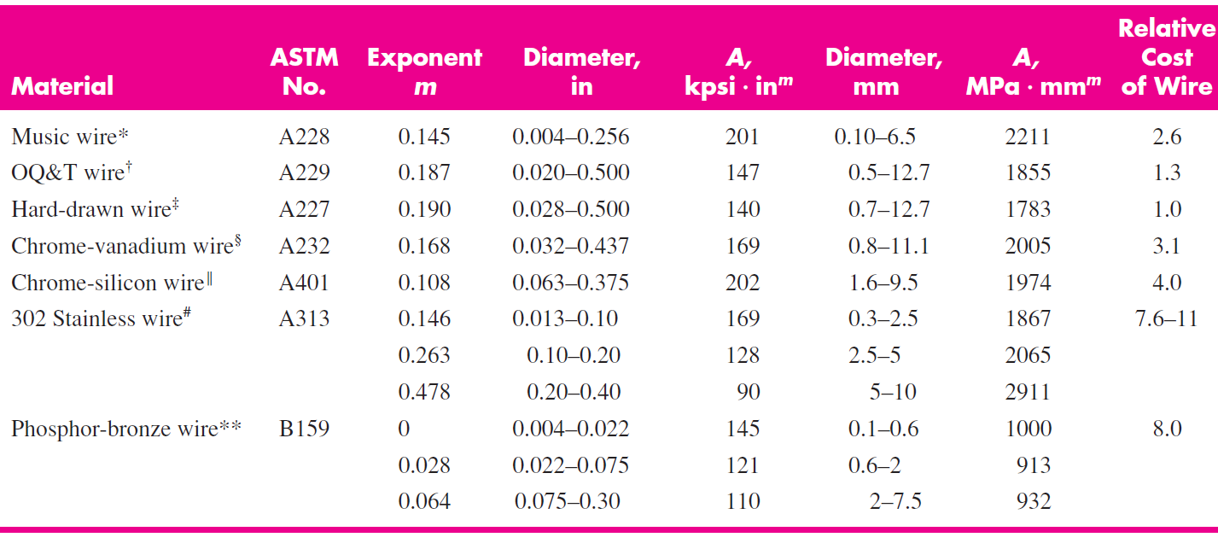
Constants for Estimating Tensile Strength
Table 10–4

Slide 19
Estimating Torsional Yield Strength
Since helical springs experience shear stress, shear yield strength is needed.
If actual data is not available, estimate from tensile strength
Assume yield strength is between 60-90% of tensile strength
Assume the distortion energy theory can be employed to relate the shear strength to the normal strength.
S_{sy} = 0.577S_{y}
This results in

Slide 20
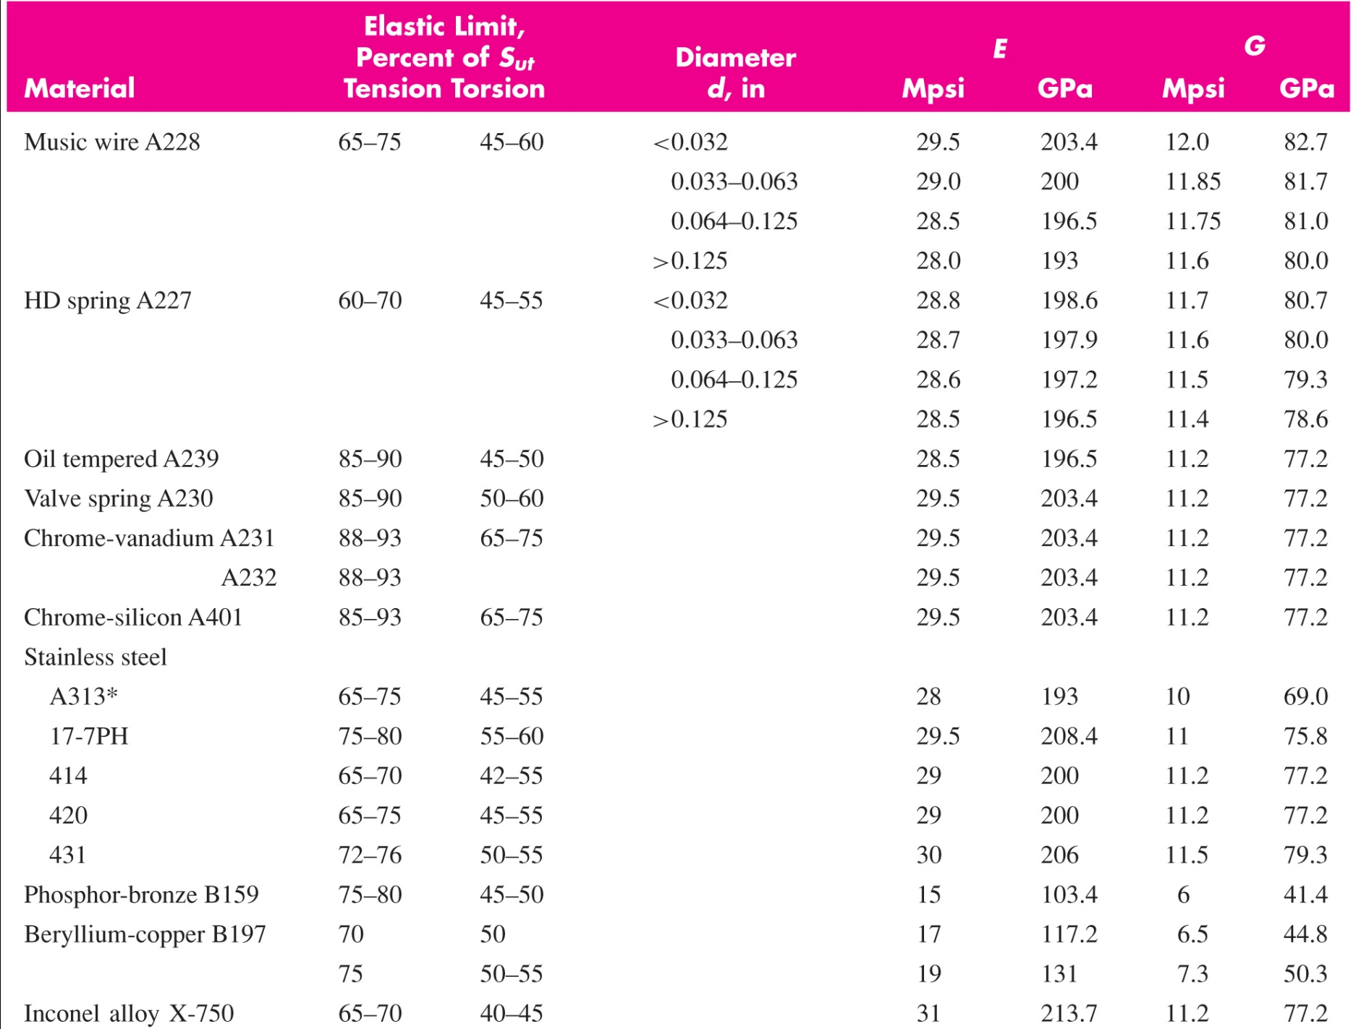
Mechanical Properties of Some Spring Wires (Table 10–5)

Slide 21
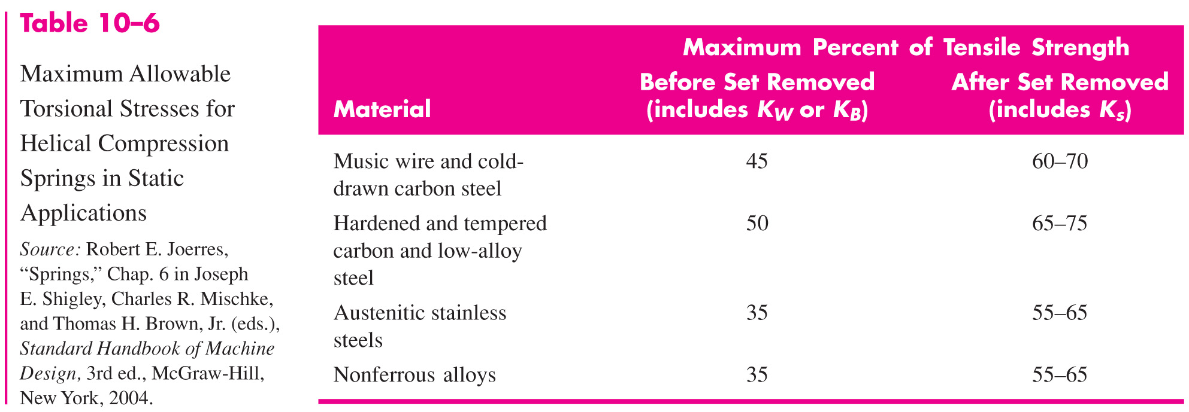
Maximum Allowable Torsional Stresses

Slide 22
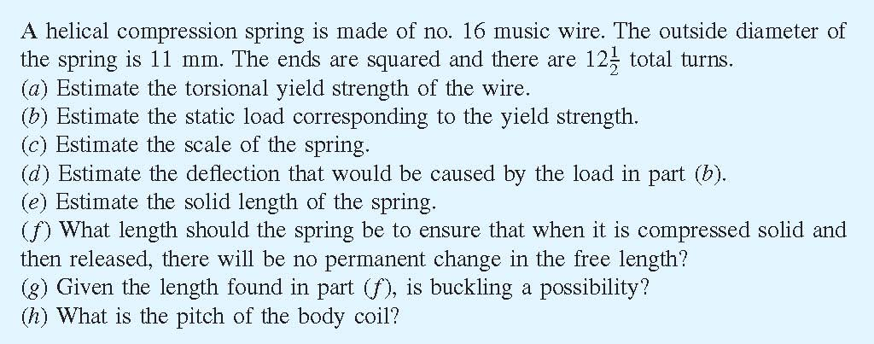
Example 10–1

Slide 23
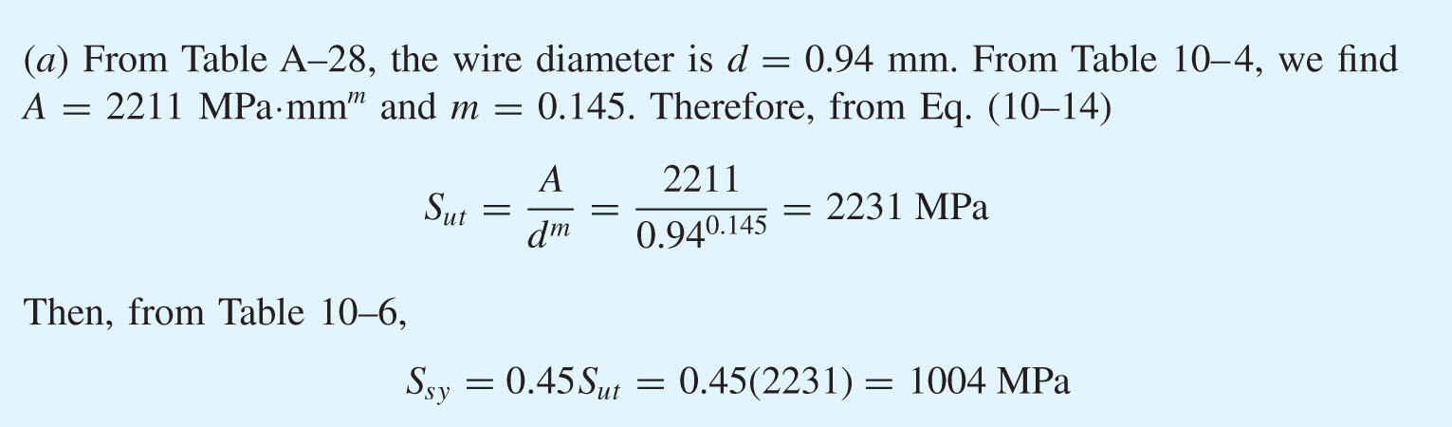
Example 10–1

Slide 24
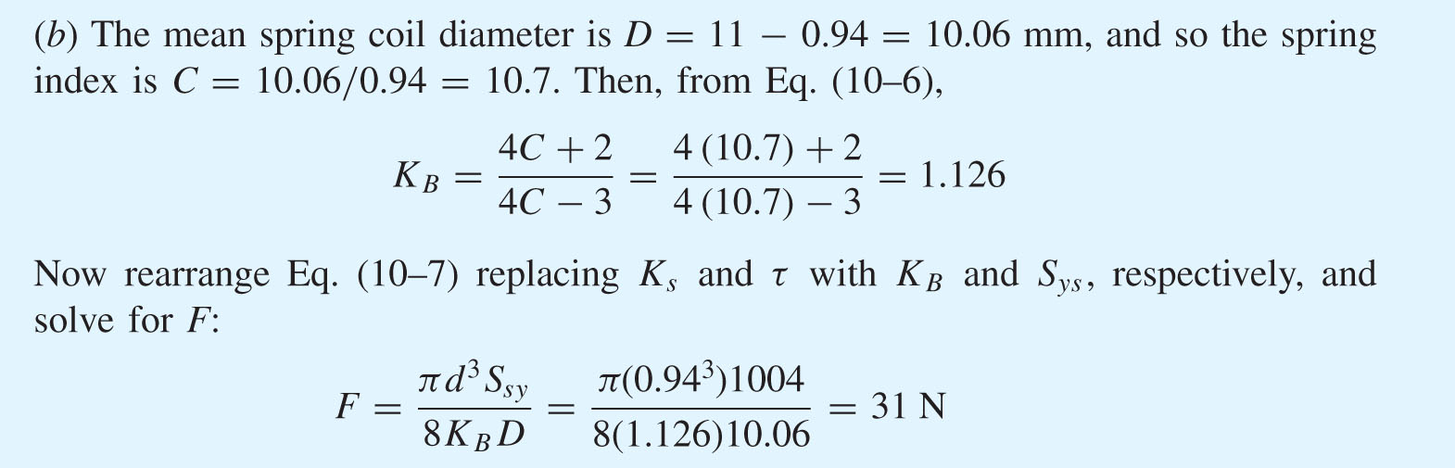

Example 10–1

Slide 25
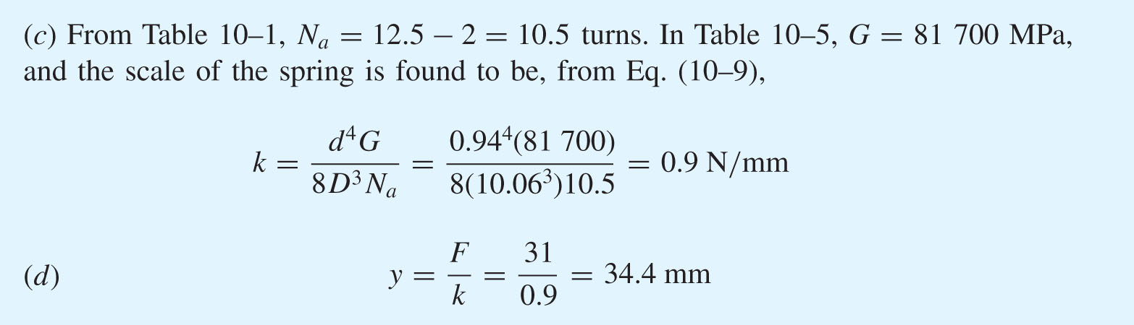
Example 10–1

Slide 26
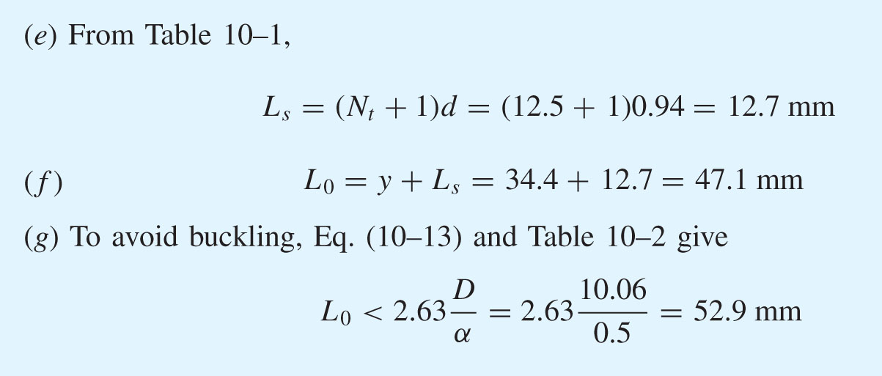
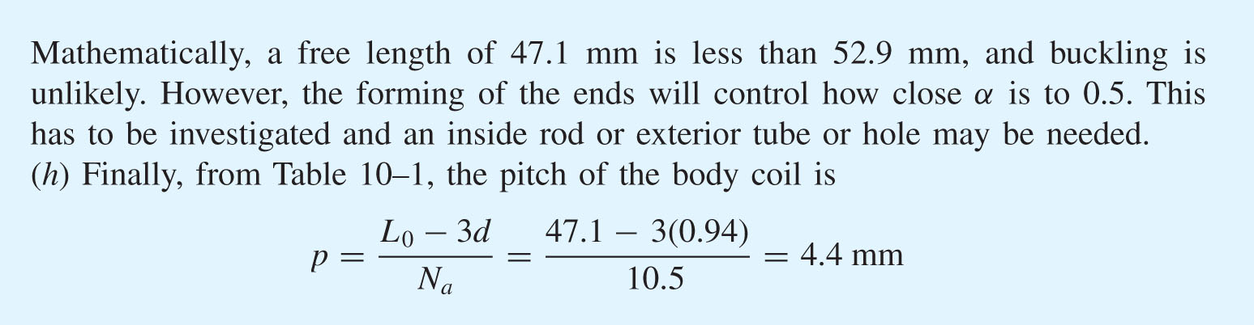
Example 10–1

Slide 27
Helical Compression Spring Design for Static Service
Limit the design solution space by setting some practical limits
Preferred range for spring index
Preferred range for number of active coils

Slide 28
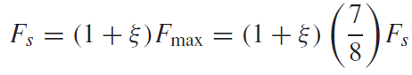
Helical Compression Spring Design for Static Service
To achieve best linearity of spring constant, preferred to limit operating force to the central 75% of the force-deflection curve between F = 0 and F = F_{s}.
This limits the maximum operating force to F_{max} ≤ 7/8 F_{s}
Define fractional overrun to closure as ξ where
This leads to
Solving the outer equality for ξ, ξ = 1/7 = 0.143 0.15
Thus, it is recommended that

Slide 29
Summary of Recommended Design Conditions
The following design conditions are recommended for helical compression spring design for static service
where n_{s} is the factor of safety at solid height.

Slide 30
Figure of Merit for High Volume Production
For high volume production, the figure of merit (fom) may be the cost of the wire.
The fom would be proportional to the relative material cost, weight density, and volume

Slide 31
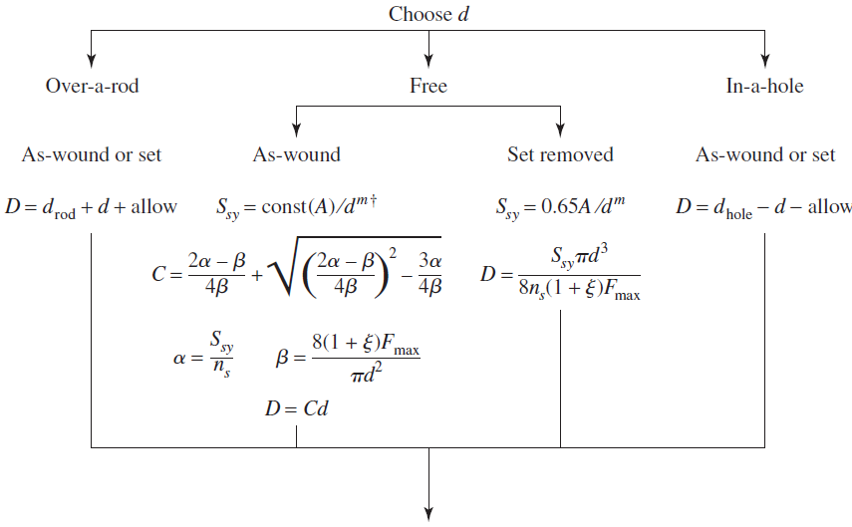
Design Flowchart for Static Loading
Continue on next slide

Slide 32
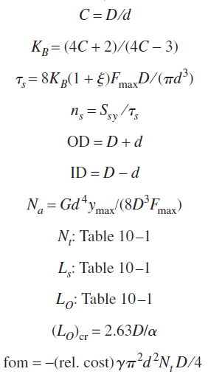
Design Flowchart for Static Loading
Continued from previous slide

Slide 33
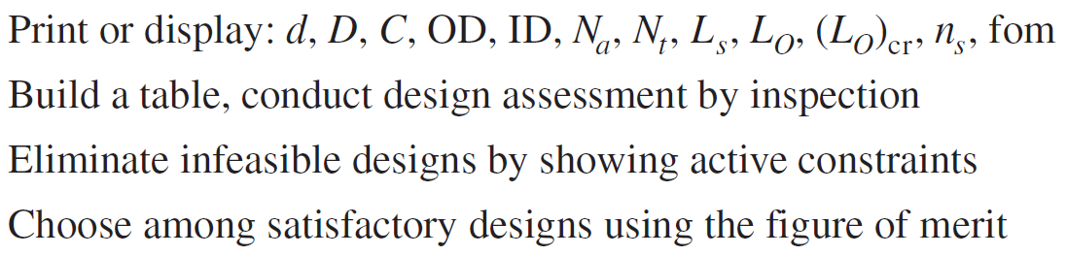
Design Flowchart for Static Loading

Slide 34
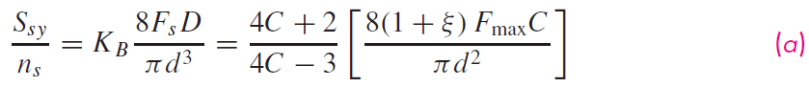
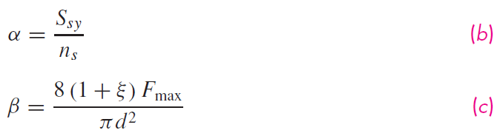
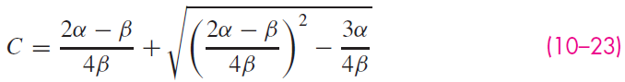
Finding Spring Index for As-Wound Branch
In the design flowchart, for the branch with free, as-wound condition, the spring index is found as follows:
From Eqs. (10–3) and (10–17),
Let
Substituting (b) and (c) into (a) yields a quadratic in C.

Slide 35
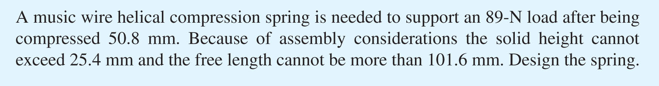

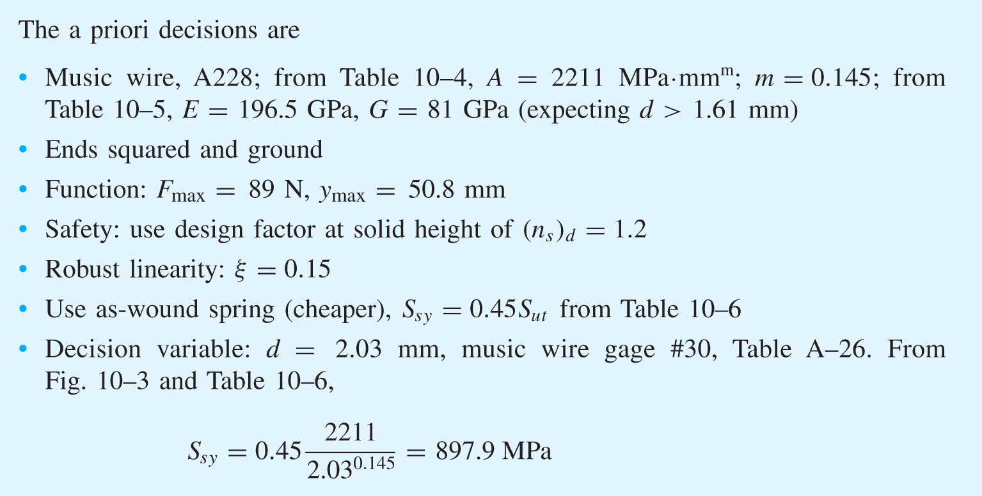
Example 10–2

Slide 36

Example 10–2

Slide 37

Example 10–2

Slide 38


Example 10–2

Slide 39

Example 10–3

Slide 40

Example 10–3

Slide 41

Example 10–3

Slide 42

Example 10–3

Slide 43

Example 10–3

Slide 44

Critical Frequency of Helical Springs
When one end of a spring is displaced rapidly, a wave called a spring surge travels down the spring.
If the other end is fixed, the wave can reflect back.
If the wave frequency is near the natural frequency of the spring, resonance may occur resulting in extremely high stresses.
Catastrophic failure may occur, as shown in this valve-spring from an over-revved engine.
Fig. 10–4

Slide 45


Critical Frequency of Helical Springs
The governing equation is the wave equation

Slide 46



Critical Frequency of Helical Springs
The solution to this equation is harmonic and depends on the given physical properties as well as the end conditions.
The harmonic, natural, frequencies for a spring placed between two flat and parallel plates, in radians per second, are
In cycles per second, or hertz,
With one end against a flat plate and the other end free,

Slide 47

Critical Frequency of Helical Springs
The weight of a helical spring is
The fundamental critical frequency should be greater than 15 to 20 times the frequency of the force or motion of the spring.
If necessary, redesign the spring to increase k or decrease W.

Slide 48


Fatigue Loading of Helical Compression Springs
Zimmerli found that size, material, and tensile strength have no effect on the endurance limits of spring steels in sizes under 3/8 in (10 mm).
Testing found the endurance strength components for infinite life to be
These constant values are used with Gerber or Goodman failure criteria to find the endurance limit.

Slide 49

Fatigue Loading of Helical Compression Springs
For example, with an unpeened spring with S_{su} = 1480 MPa, the Gerber ordinate intercept for shear, from Eq. (6–42), is
For the Goodman criterion, it would be S_{se} = 331.1 MPa.
Each possible wire size would change the endurance limit since S_{su} is a function of wire size.

Slide 50
Fatigue Loading of Helical Compression Springs
It has been found that for polished, notch-free, cylindrical specimens subjected to torsional shear stress, the maximum alternating stress that may be imposed is constant and independent of the mean stress.
Many compression springs approach these conditions.
This failure criterion is known as the Sines failure criterion.

Slide 51
Torsional Modulus of Rupture
The torsional modulus of rupture S_{su} will be needed for the fatigue diagram.
Lacking test data, the recommended value is

Slide 52




Stresses for Fatigue Loading
From the standard approach, the alternating and midrange forces are
The alternating and midrange stresses are

Slide 53

Example 10–4

Slide 54


Example 10–4

Slide 55

Example 10–4

Slide 56

Example 10–4

Slide 57

Example 10–4

Slide 58

Example 10–4

Slide 59

Example 10–5

Slide 60

Example 10–5

Slide 61

Example 10–5

Slide 62

Example 10–5

Slide 63

Example 10–5

Slide 64

Example 10–5

Slide 65

Example 10–5

Slide 66

Example 10–5

Slide 67

Extension Springs
Extension springs are similar to compression springs within the body of the spring.
To apply tensile loads, hooks are needed at the ends of the springs.
Some common hook types:
Fig. 10–6

Slide 68




Stress in the Hook
In a typical hook, a critical stress location is at point A, where there is bending and axial loading.
(K)_{A} is a bending stress-correction factor for curvature
Fig. 10–7

Slide 69



Stress in the Hook
Another potentially critical stress location is at point B, where there is primarily torsion.
(K)_{B} is a stress-correction factor for curvature.
Fig. 10–6

Slide 70

An Alternate Hook Design
This hook design reduces the coil diameter at point A.
Fig. 10–6

Slide 71
Close-wound Extension Springs
Extension springs are often made with coils in contact with one another, called close-wound.
Including some initial tension in close-wound springs helps hold the free length more accurately.
The load-deflection curve is offset by this initial tension F_{i}

Slide 72


Terminology of Extension Spring Dimensions
The free length is measured inside the end hooks.
The hooks contribute to the spring rate. This can be handled by obtaining an equivalent number of active coils.
Fig. 10–7

Slide 73


Initial Tension in Close-Wound Springs
Initial tension is created by twisting the wire as it is wound onto a mandrel.
When removed from the mandrel, the initial tension is locked in because the spring cannot get any shorter.
The amount of initial tension that can routinely be incorporated is shown.
The two curves bounding the preferred range is given by
Fig. 10–7c

Slide 74

Guidelines for Maximum Allowable Stresses
Recommended maximum allowable stresses, corrected for curvature effect, for static applications is given in Table 10–7.
Table 10–7

Slide 75


Example 10–6

Slide 76

Example 10–6

Slide 77

Example 10–6

Slide 78

Example 10–6

Slide 79

Example 10–6

Slide 80

Example 10–6

Slide 81



Example 10–7

Slide 82

Example 10–7

Slide 83

Example 10–7

Slide 84

Example 10–7

Slide 85

Example 10–7

Slide 86

Helical Coil Torsion Springs
Helical coil springs can be loaded with torsional end loads.
Special ends are used to allow a force to be applied at a distance from the coil axis.
Usually used over a rod to maintain alignment and provide buckling resistance.
Fig. 10–8

Slide 87



End Locations of Torsion Springs
Terminology for locating relative positions of ends is shown.
The initial unloaded partial turn in the coil body is given by
The number of body turns N_{b} will be the full turns plus the initial partial turn.
Fig. 10–9

Slide 88

End Locations of Torsion Springs
Commercial tolerances on relative end positions is given in Table 10–9

Slide 89



Stress in Torsion Springs
The coil of a torsion spring experiences bending stress (despite the name of the spring).
Including a stress-correction factor, the stress in the coil can be represented by
The stress-correction factor at inner and outer fibers has been found analytically for round wire to be
K_{i} is always larger, giving the highest stress at the inner fiber.
With a bending moment of M = Fr, for round wire the bending stress is

Slide 90

Spring Rate for Torsion Springs
Angular deflection is commonly expressed in both radians and revolutions (turns).
If a term contains revolutions, the variable will be expressed with a prime sign.
The spring rate, if linear, is
where moment M can be expressed as Fl or Fr.

Slide 91



Deflection in the Body of Torsion Springs
Use Castigliano’s method to find the deflection in radians in the body of a torsion spring.
Let M = Fl = Fr, and integrate over the length of the body-coil wire. The force F will deflect through a distance rθ.
Using I for round wire, and solving for θ,

Slide 92

Deflection in the Ends of Torsion Springs
The deflection in the ends of the spring must be accounted for.
The angle subtended by the end deflection is obtained from standard cantilever beam approach.

Slide 93
Deflection in Torsion Springs
The total angular deflection is obtained by combining the body deflection and the end deflection.
With end lengths of l₁ and l₂, combining the two deflections previously obtained gives,

Slide 94

Equivalent Active Turns
The equivalent number of active turns, including the effect of the ends, is

Slide 95




Spring Rate in Torsion Springs
The spring rate, in torque per radian
The spring rate, in torque per turn
To compensate for the effect of friction between the coils and an arbor, tests show that the 10.2 should be increased to 10.8.
Expressing Eq. (10–47) in revolutions, and applying the same correction for friction, gives the total angular deflection as

Slide 96



Decrease of Inside Diameter
A torsion spring under load will experience a change in coil diameter.
If the spring is over a pin, the inside diameter of the coil must not be allowed to decrease to the pin diameter.
The angular deflection of the body of the coil, extracted from the total deflection in Eq. (10–52), is
The new helix diameter D' of a deflected coil is
The new inside diameter is

Slide 97


Decrease of Inside Diameter
The diametral clearance Δ between the body coil and the pin of diameter D_{p} is
Solving for N_{b},
This gives the number of body turns necessary to assure a specified diametral clearance.

Slide 98

Static Strength for Torsion Springs
To obtain normal yield strengths for spring wires loaded in bending, divide values given for torsion in Table 10–6 by 0.577 (distortion energy theory). This gives

Slide 99

Fatigue Strength for Torsion Springs
The Sines method and Zimmerli data were only for torsional stress, so are not applicable.
Lacking better data for endurance limit in bending, use Table 10–10, from Associated Spring for torsion springs with repeated load, to obtain recommended maximum bending stress S_{r}.

Slide 100

Fatigue Strength for Torsion Springs
Next, apply the Gerber criterion to obtain the endurance limit.
Note that repeated loading is assumed.
This accounts for corrections for size, surface finish, and type of loading, but not for temperature or miscellaneous effects.

Slide 101



Fatigue Factor of Safety for Torsion Springs
Applying the Gerber criterion as usual from Table 6–7, with the slope of the load line r = M_{a}/M_{m},
Or, finding n_{f} directly using Table 6–7,

Slide 102


Example 10–8
Fig. 10–10

Slide 103

Example 10–8

Slide 104

Example 10–8

Slide 105

Example 10–8

Slide 106

Example 10–8

Slide 107

Example 10–8

Slide 108

Belleville Springs
The Belleville spring is a coned-disk spring with unique properties
It has a non-linear spring constant
With h/t ≥ 2.83, the S curve can be useful for snap-acting mechanisms
For 1.41≤ h/t ≤ 2.1 the flat central portion provides constant load for a considerable deflection range
Fig. 10-12

Slide 109

Constant-Force Springs
The extension spring shown is made of slightly curved strip steel, not flat.
The fore required to uncoil it remains constant.
Known as a constant-force spring.
Fig. 10-13

Slide 110
Conical Spring
A conical spring is wound in the shape of a cone.
Most are compression springs, made with round wire.
The principal advantage is that the solid height is only a single wire diameter.

Slide 111

Volute Spring
A volute spring is a conical spring made from a wide, thin strip, or “flat”, of material wound on the flat so that the coils fit inside one another.
Since the coils do not stack on each other, the solid height is the width of the strip.
A variable-spring scale is obtained by permitting the coils to contact the support.
As deflection increases (in compression), the number of active coils decreases.
Fig. 10–13

Slide 112


Constant-Stress Cantilever Spring
A uniform-section cantilever spring made from flat stock has stress which is proportional to the distance x.
It is often economical to proportion the width b to obtain uniform stress, independent of x.

Slide 113




Constant-Stress Cantilever Spring
For a rectangular section, I/c = bh²/6.
Combining with Eq. (a),
Solving for b,
Since b is linearly related to x, the width b_{o} at the base is
Fig. 10–13

Slide 114




Constant-Stress Cantilever Spring
Apply Castigliano’s method to obtain deflection and spring constant equations.
The width is a function of x,
Integrating Castigliano’s deflection equation with M and I both functions of x,
Thus, the spring constant, k = F/y, is
Fig. 10–13b

Slide 115


